Slide 1
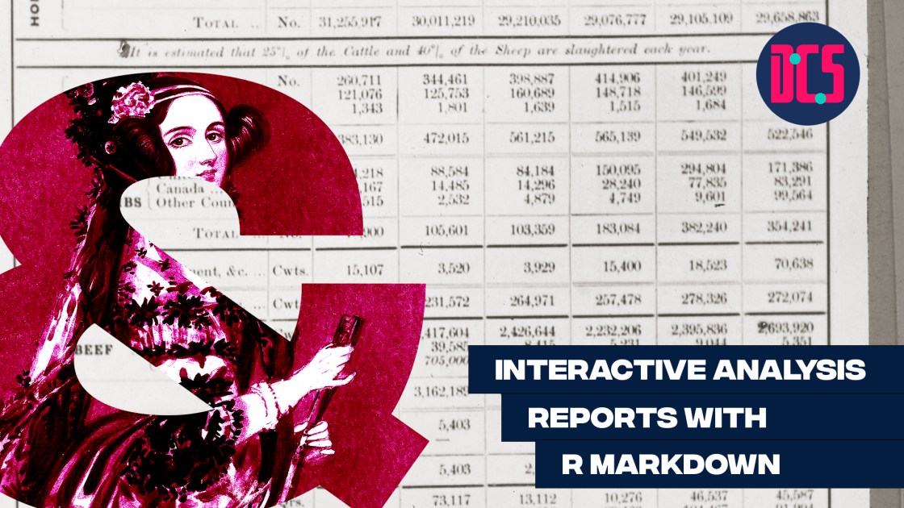

Slide 2

Why make our reports in R markdown?
It can save us a lot of time and pain with reporting our analyses (and spend less time trying to make tables in word!).
It can ensure that are recorded results are accurate.
We can quickly update our analysis report when changes are needed.
It can provide us with extra tools to communicate our research.
We can make our analysis report interactive! It can suit the needs of those who want depth and those who want the brief summary.
Imagine being able to store your analysis section at a conference poster in a QR code - give it a scan to see some of the tricks we will learn today ->
Our own analysis webpage!

Slide 3
Output style
Both Quarto and R markdown allow you to provide a variety of file outputs.
The 3 main common outputs for generating reports are html, pdf, and docx (word output). (Others exist as well!).
Html is very flexible, will behave nicely with most packages, and allows for interactive documents that can be hosted online.
Pdf’s will look beautiful, but some features of LaTeX working behind the scenes require some additional work/packages. It is easier to render pdf’s with quarto in comparison to R markdown.
Word documents will render, but some packages will not work here. It is possible to create tables with gt(), but they may require reshaping (Microsoft will not allow us to avoid this painful step).

Slide 4
Workshop aims:
Learn the basic features of an analysis report in Quarto:
Learn about the YAML
Create different output styles with the YAML
Using header levels effectively.
Code boxes.
Making tables.
In text coding to report our stats.
Plots!

Slide 5
Structure for today:
Quick scan and overview of features of analysis reports in R (code chunks, table of contents, inline coding).
Working in pairs and using the document as a source of code, create your own analysis report on the Penguins data set.
Bonus (if time) - Other opportunities for interactive documents – Making Dashboards and using Shiny.
Bonus (if time allows) – Learn how to host an interactive html document on gitub

Slide 6




R – Markdown code tips:
YAML template for interactive html
---
title: "Research Report“
author: "Rhys”
date: "`r Sys.Date()`“
output:
html_document:
toc: true
toc_float: true
theme: spacelab
highlight: espresso
---
# Header level 1
## Header level 2
### Header level 3
#### Header level 4
```{r, echo = FALSE}
# setting echo to FALSE hides the code in the rendered document
```
*Italic text*
**Bold text**
* Making bullet point list
* Point 1
* Point 2
Inline coding with
`r mean(data$variable_name)`
# Setting tabs {.tabset}
## Setting pillbox tabs {.tabset .tabset-pills}
Demonstrate mathematical notation with by wrapping with $. (e.g. $R^2_{adj}$ , $\beta$).
Text formatting in Rmd
Html tips in Rmd
Word docs in Rmd
In-depth word docs in Rmd

Slide 7

GitHub Web hosting guide
Step 1 – Have a GitHub account (This is a great way to engage with open research practice, and you can learn a lot about other researcher’s coding/analysis practices through GitHub).
Step 2 – Create new repository. Name it whatever you want but finish the name with “.github.io” (This allows for webpage hosting).
Step 3 – Set the repository to public, choose appropriate license (creative commons is generally what we need in research), and add some useful contextualising info on the Readme.
Step 4 – Upload your rmd code and html file. Important quirk for webhosting – name your html file “index”.
Step 5 – Go to settings, and go to “pages” , scroll to the “Build and development” heading, and change Source to “GitHub Actions”.
Step 6 – Configure your page to a “Static Html” doc.
Step 7 – Wait a minute or two for loading, then check the link!
Congratulations! You have contributed to the internet!
Bonus step – Use a QR code generator to help your audience access your analysis page.

